Slide 1

Sample & Population

Slide 2
Population
1

Slide 3
Population
A population is a group of items we may be interested for the purposes of a particular (empirical) study.
Examples of Populations:
Pandas
Human beings
Fish
The population of France
Cars
Books
...

Slide 4
Population
Often we want to estimate a particular parameter of a certain population. A parameter is simply a (statistical) computable property of a given population.
Examples:
Pandas: Reproduction Rate
Human beings: Life Expectancy
Fish: % of flying fish
The population of France: Average height
Cars: The # of cars top speed > 300 km/h
Books: # books written in Swedish
...

Slide 5
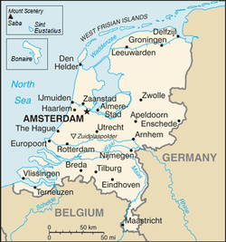
Population
Parameters (property of a population):
Life Expectancy
Average Height
Most frequent hair colour
…

Slide 6
Population
How do we find these properties or parameters?
Make an observation for the entire population....
Take a sample of the population!

Slide 7
Sample
2

Slide 8
Sample
A sample is a set of items (e.g. inhabitants of a country) that are selected - or sampled - from the wider population.
As such, it is a subset of items in the population. We take a subset because often we cannot observe the entire population.

Slide 9
Sample
When we sample, we simply do the following:
We select at random n (could be 10, 20, 1000, etc.) items from the population.
We compute a statistic (a ‘parameter’ of the sample). This statistic is, in a way, the next best thing to finding the population parameter as it allows us to approximate the population parameter.

Slide 10
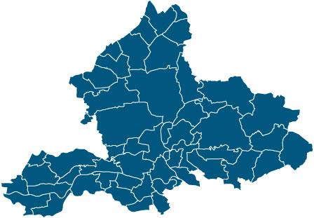
Population
Suppose we want to estimate the average height in the Netherlands.
Would this be a good sample?

Slide 11
A Representative Sample
3

Slide 12
Population
👨
👦
👸
👷
Sample
👷👦👷👳👵
💂👩👮👸👨
👷
👳
👮
👵
👩
💂

Slide 13
A Representative Sample
This way of sampling (i.e. by using a random sample) is much better than what we did before. What can we do to improve the approximation of the parameter?
We can take a larger sample!
Important: As the sample size increases, it becomes more and more likely that we find a statistic (e.g. mean height, life expectancy etc.) that is close to the real parameter in the population.

Slide 14
Your turn.
4

Slide 15
Your turn.
I’ve just shown you an example of the Netherlands. Now it’s your turn. We’ll assign you to groups of 2 (in breakout rooms). Together, come up with a population, a parameter your interested in as well as an approach as to how to would find the statistic of the sample.
We will reconvene in 10 minutes and 2 groups will have to present their findings.

Slide 16
Your turn.
Example and format:
Parameter: The % of tourist between 30 and 50 years old currently on holiday in Amsterdam.
Population: All tourists currently on holiday in Amsterdam.
Sample: Select at random n (30, 90, 120…) from the streets and ask them for their age. (Pick an n that seems reasonable.
Statistic: The % of tourist between 30 and 50 currently on holiday in Amsterdam in the sample.

Slide 17
The End.

